Slide 1
COMP30027 MACHINE LEARNING
TUTORIAL
Workshop - 2

Slide 2

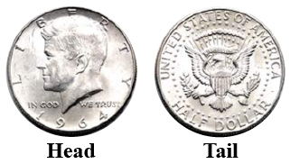

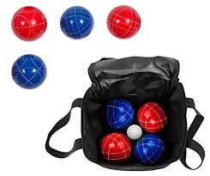
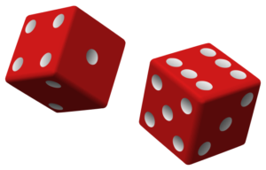
https://www.thoughtco.com/standard-deck-of-cards-3126599
https://www.amazon.com.au/Bocce-Ball-Premium-Set-Innovations/dp/B00EEQ09JS
https://www.cuemath.com/data/tossing-a-coin/
https://www.toppr.com/guides/maths/probability/how-to-calculate-dice-probabilities/

Slide 3

Navigating the World of
Probability
Welcome to our exploration of probability. We'll journey from basic definitions to probability distributions

Slide 4

Understanding Basic Probability
Definition
Basic Rules
Deck of Card Example
Probability measures the likelihood of an event occurring. It ranges from 0 (impossible) to 1 (certain).
The sum of all probabilities in a sample space equals 1. The probability of impossible events is 0.
P(red card) = P(black card) = 26/52=0.5

Slide 5
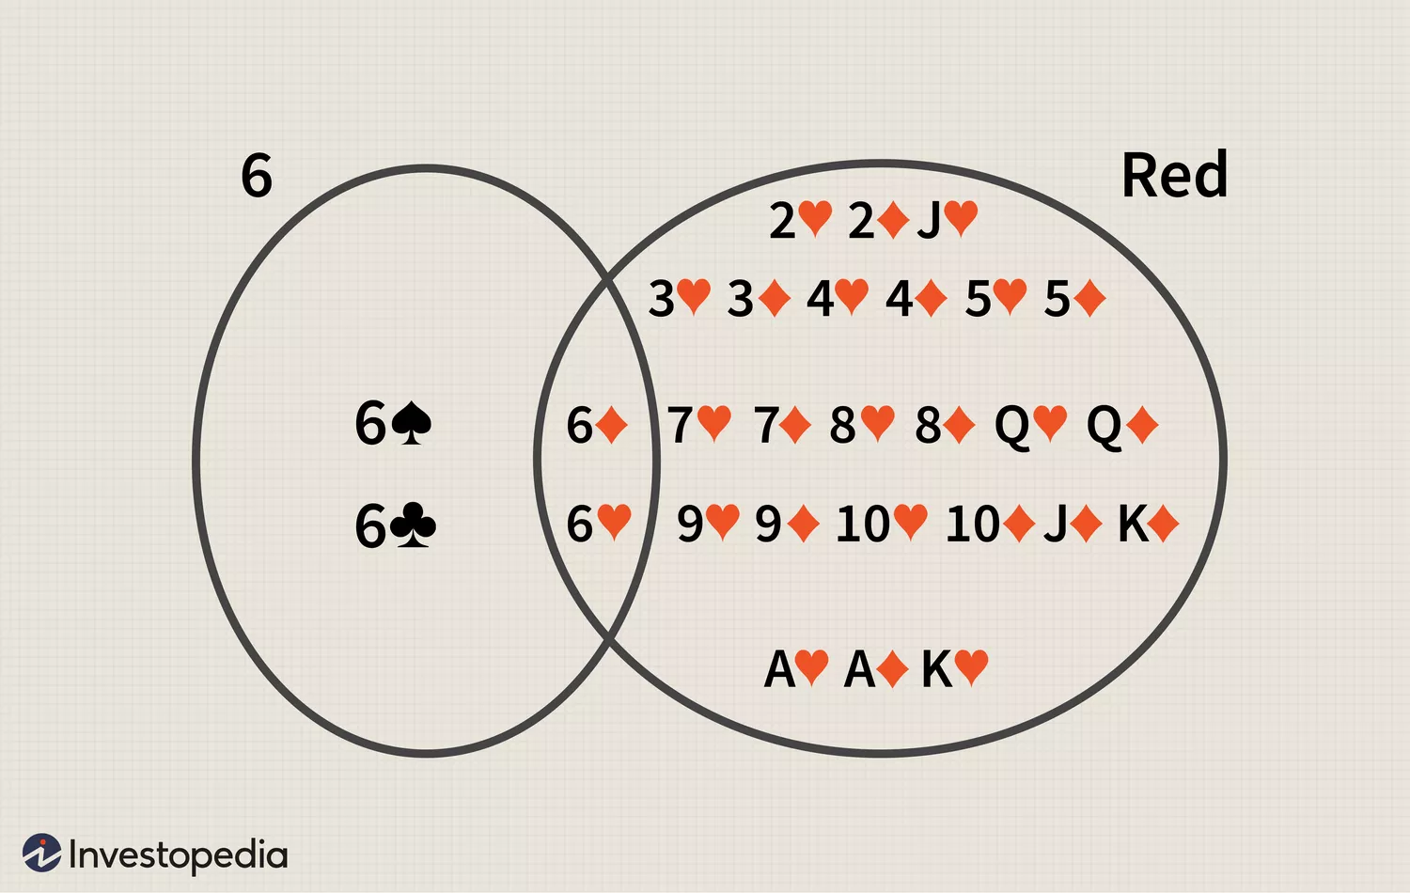
Joint Probability
Definition
Formula
Card Example
Joint probability is the likelihood of two events occurring together. It's denoted as P(A and B) or P(A ∩ B).
For independent events: P(A and B) = P(A) × P(B). For dependent events, we use the conditional probability formula.
The probability of drawing a red `6’ card is
P(6∩red)=P(6)×P(red)=4/52×26/52=1/26

Slide 6
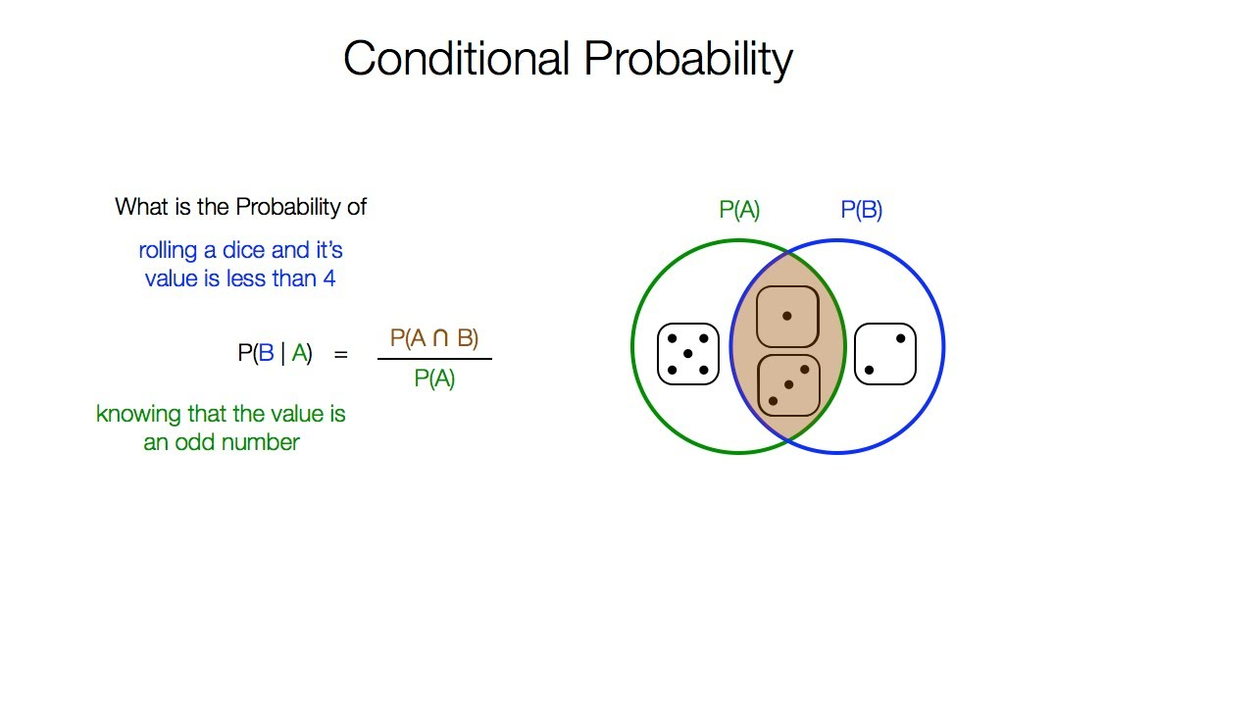



Conditional Probability
Definition
The probability of event A occurring given that event B has occurred. It represents updated probabilities with new information.
Formula
P(A|B) = P(A and B) / P(B), where P(B) > 0.
Example
https://www.youtube.com/watch?v=H02B3aMNKzE

Slide 7

Marginal Probability
Definition
Calculation
Marginal probability is the probability of an event occurring regardless of the outcome of another variable.
Found by summing joint probabilities across all values of the other variable.
Class Example
If 40% of students are male, P(Male) = 0.4 is a marginal probability, regardless of other student attributes.

Slide 8
Q1
Approximately 1% of women aged between 40 and 50 have breast cancer. 80% of mammogram screening tests detect breast cancer when it is there. 90% of mammograms DO NOT show breast cancer when it’s NOT there. Use this information to complete the following table with:
the joint probabilities P(Cancer,Test) for each possible pair of cancer status and test result
the conditional probabilities P(Test|Cancer) for each test result given cancer status
Cancer | Test | Joint prob. | Conditional prob.
Yes | Positive |  | 80%
Yes | Negative
No | Positive
No | Negative |  | 90%

Slide 9
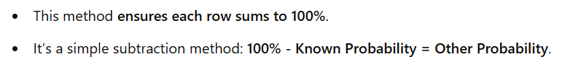
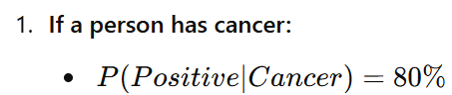
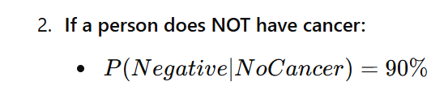
Compute the Conditional Probabilities
Cancer | Test | Joint prob. | Conditional prob.
Yes | Positive |  | 80%
Yes | Negative
No | Positive
No | Negative |  | 90%
20%
10%

Slide 10
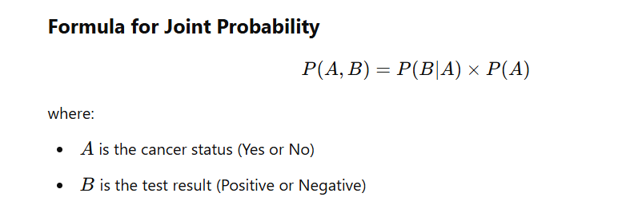
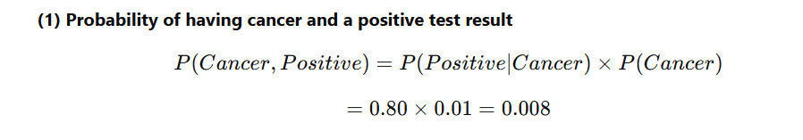
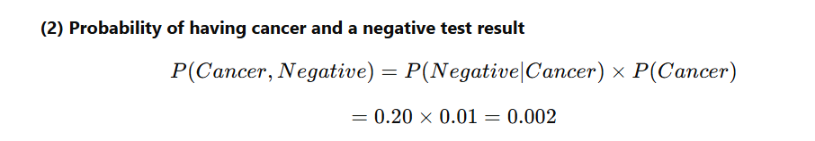
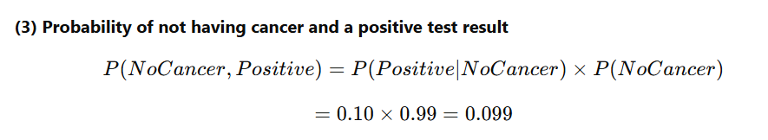
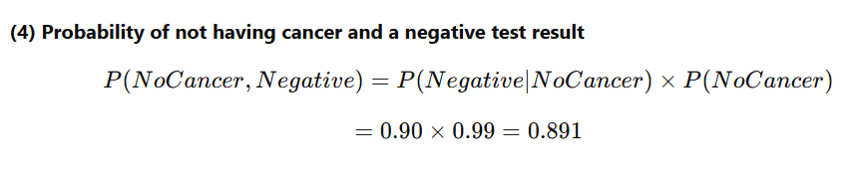
Cancer | Test | Joint prob. | Conditional prob.
Yes | Positive |  | 80%
Yes | Negative |  | 20%
No | Positive |  | 10%
No | Negative |  | 90%
0.8%
0.2%
9.9%
89.1%

Slide 11
Q2
Given the table above, compute the marginal probability of a positive result in the mammogram screening test.
The marginal probability is the total probability of a positive result:
P(Test == Positive|Cancer == No)P(Cancer == No) + P(Test == Positive|Cancer == Yes)P(Cancer == Yes)
this is the sum of the two joint probabilities in the table above:
P(Test == Positive,Cancer == No) + P(Test == Positive,Cancer == Yes)
=> 0.8 + 9.9 = 10.7%
Cancer | Test | Joint prob. | Conditional prob.
Yes | Positive |  | 80%
Yes | Negative |  | 20%
No | Positive |  | 10%
No | Negative |  | 90%
0.8%
0.2%
9.9%
89.1%

Slide 12
Q3
Suppose a woman in this age group receives a positive test result. Compute the conditional probability P(Cancer == Yes|Test == Postive).
This is equivalent to the joint probability P(Test == Positive, Cancer == Yes) over the total probability of a positive result:
P(Test == Positive,Cancer == Yes) / P(Test == Yes)
0.8 / 10.7 = 7.5%
This result shows that even if a screening test returns a positive result, the actual chance of cancer is only 7.5%.

Slide 13
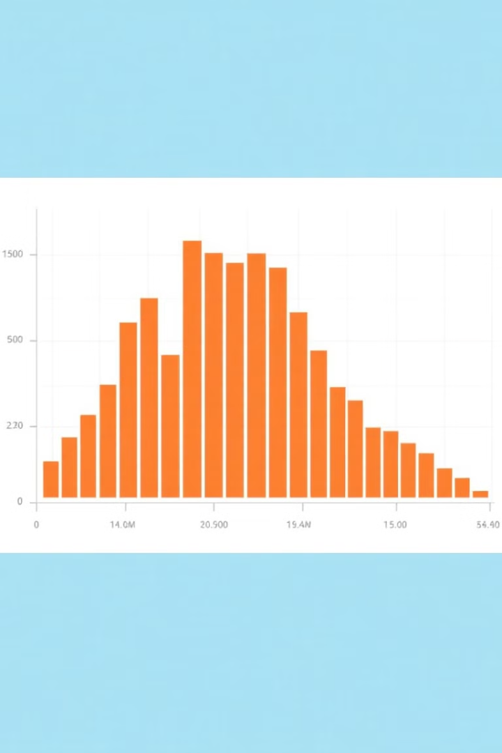
Empirical Probability Distribution
Data Collection
Gather observations from real-world experiments or surveys. Record frequencies of each outcome.
Frequency Analysis
Count occurrences of each value. Divide by total observations to get relative frequencies.
Distribution Creation
Plot these relative frequencies. They approximate the true probability distribution as sample size increases.

Slide 14
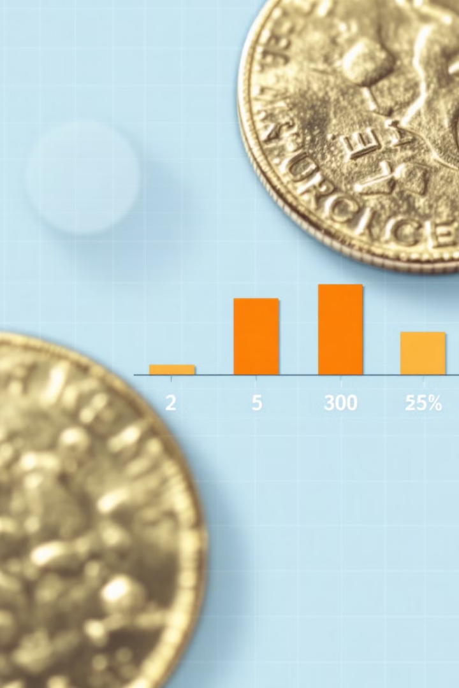



Binomial Distribution
Definition
Formula
Coin Example
Models the number of successes in n independent trials, each with probability p of success.
P(X = k) = C(n,k) × p^k × (1-p)^(n-k) where C(n,k) is the binomial coefficient.
For 3 heads in 5 flips: P(X = 3) = C(5,3) × (0.5)^3 × (0.5)^2 = 10 × 0.03125 = 0.3125.

Slide 15
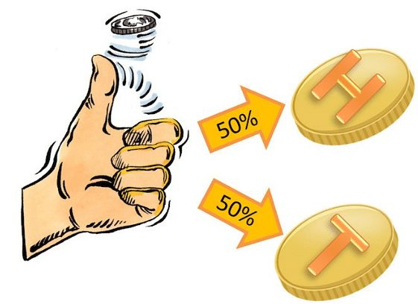
Q4
Suppose you flip a fair coin 10 times. What are the odds that you will get exactly K heads, for each possible value of K (0,1,...10)? Write a function to simulate this experiment and empirically estimate the probability distribution.
Simulate flipping coin 10 time
Count number of heads in each experiment
Plot the probability distribution
https://in.pinterest.com/pin/coin-toss-probability-formula-solved-examples-in-2024--933652566490495490/

Slide 16




Probability Density Function
Definition
Properties
A function whose integral gives probabilities for continuous random variables.
1
PDFs must be non-negative and integrate to 1 over the entire domain.
2
Interpretation
Normal Distribution
4
The PDF value itself isn't a probability. Probabilities come from areas under the curve.
3
The bell curve with PDF f(x) = (1/σ√2π) × e^(-(x-μ)²/2σ²) is the most common example.

Slide 17




Entropy in Probability
Definition
Formula
Entropy measures uncertainty or information content in a probability distribution.
1
2
H(X) = -Σ P(xi) × log₂(P(xi)) for all possible outcomes xi.
Properties
Coin Example
Entropy is maximized when all outcomes are equally likely. It quantifies unpredictability.
For a fair coin: H(X) = -(0.5 × log₂(0.5) + 0.5 × log₂(0.5)) = 1 bit.
4
3

Slide 18
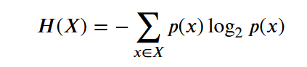
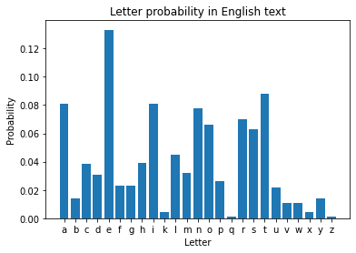
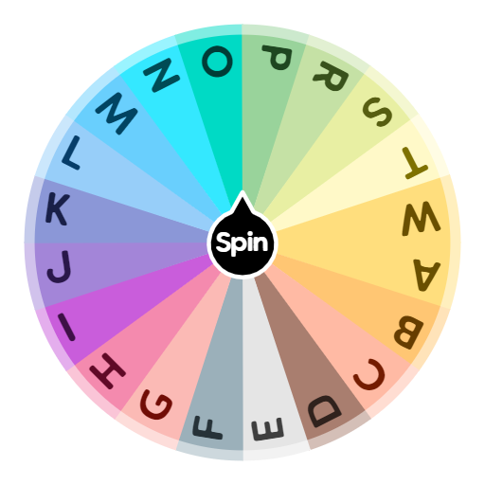
Q6
Compute the entropy of a random letter generator which can generate any of the 26 English letters (a-z), each with equal probability.
All letters (A–Z) are equally likely
Probability of each letter = 1/26
Entropy is maximum
High uncertainty: each letter is a total surprise
Letters are not equally likely (e.g., E is common, Z is rare)
More predictable due to patterns
Entropy is lower
Some information is redundant (due to structure and grammar)
https://images.app.goo.gl/c1CquByFscjNJC3Y6

Slide 19

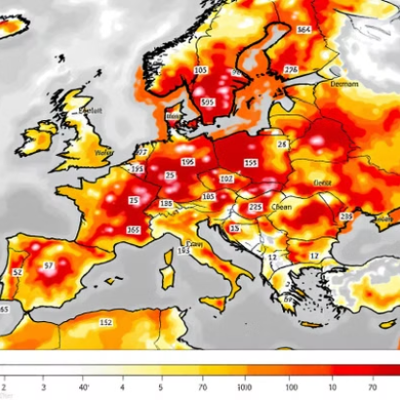

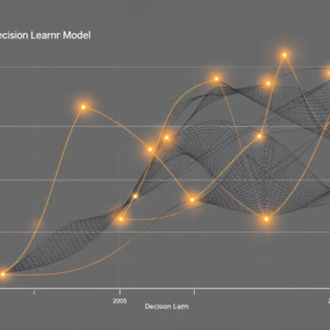
Real-world Applications of Probability
Probability concepts power financial risk assessment, weather forecasting, medical diagnostics, and AI systems. They help us navigate uncertainty in virtually every field.

Slide 20
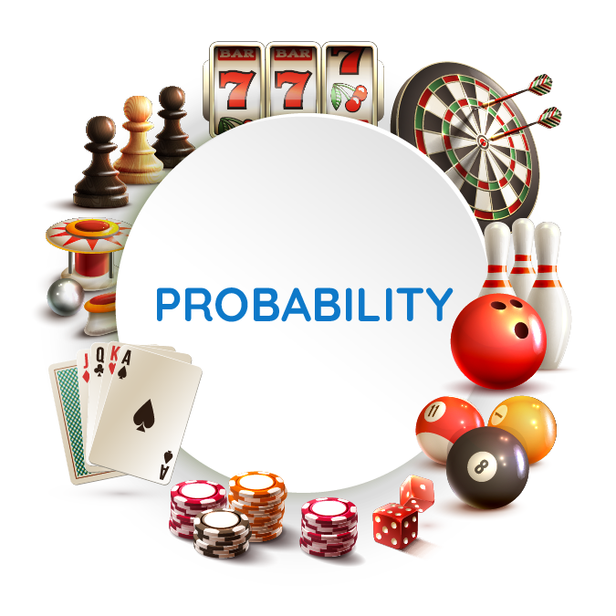
THANK YOU!!
https://images.app.goo.gl/5MxkDA5YCLFjvfZa8

